Slide 1

Шлях від аутсорсу до продуктово-консалтингової компанії: перемоги та поразки Oleksandr Krakovetskyi CEO, DevRain Solutions @msugvnua, alex.krakovetskiy@devrain.com https://www.facebook.com/alex.krakovetskiy

Slide 2
About
CEO of DevRain Solutions (software development company).
CTO DonorUA/Udonors.
Microsoft Regional Director.
Microsoft Most Valuable Professional.
Best Professional in Software Architecture (Ukrainian IT Award).
Ph.D. in Computer Science.
Community lead in Kyiv Smart City initiative, expert in Open Data.
Speaker and IT blogger.

Slide 3




DevRain Solutions
Outsourcing company with 15 people. Lead partner on creating Windows Phone apps by Microsoft Ukraine.
Developer of 20+ apps for Windows Phone and Windows 10 with 8+ million downloads in total (as publisher and owner of products).
WP7PUBLISH – platform for creating content Windows Phone apps without coding. Shortlisted as the best Ukrainian startup.
DonorUA/Udonors is an automated blood donor recruitment system. Winner of several international and local awards. DonorUA.Bot is a side project.
AppClub { build, monetize } – dev & startup community.

Slide 4
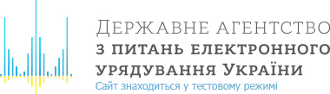










DevRain Solutions

Slide 5
Definitions
Service company provides outsourcing & outstaffing & consulting & R&D.
Consulting company is a service company with higher rates.
Product company has own product(s) that produces most of the revenue.
Startup is a product company with a different growth/exit strategy.
Publishing company is an agent for the product companies.

Slide 6

Transition models
Starting product company in parallel to the existing outsourcing business with a separate team and processes.
Re-invest profit from services for product creation.
Startup model with external investment.

Slide 7

Startup Nation
India, Ireland, Canada and Israel were the four leading countries that controlled outsourcing business in 2003.
Now Israel is a startup nation. Israeli Startup 'Exits' Top $10B In 2016.
http://www.yakaboo.ua/ua/kraina-startapiv-istorija-izrail-s-kogo-ekonomichnogo-diva.html

Slide 8
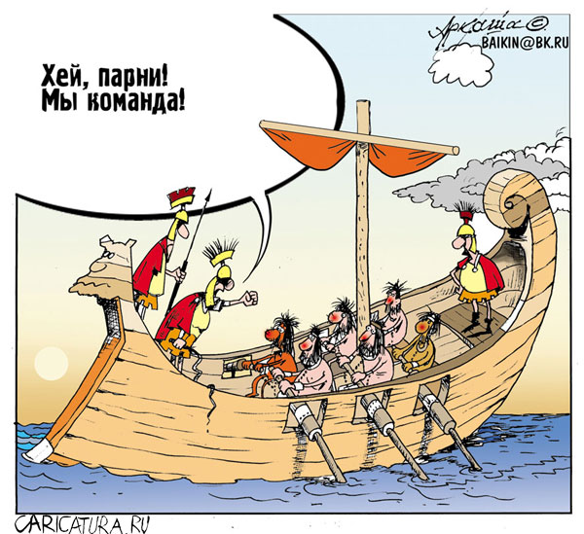
Offshore R&D
Bangalore, Yerevan, Mumbai, Ahmedabad, Bucharest, New Delhi, Hyderabad, Ho Chi Minh city, Chennai, Pune, Indore, Noida, Gurgaon, Thiruvananthapuram, Greater Toronto Area, Ottawa, Montreal, Haifa, Tel Aviv, Dublin, Lahore, Kyiv, Minsk, Moscow, and St. Petersburg would be the ideal places, and hence 'Tier I' cities to offshore R&D.

Slide 9
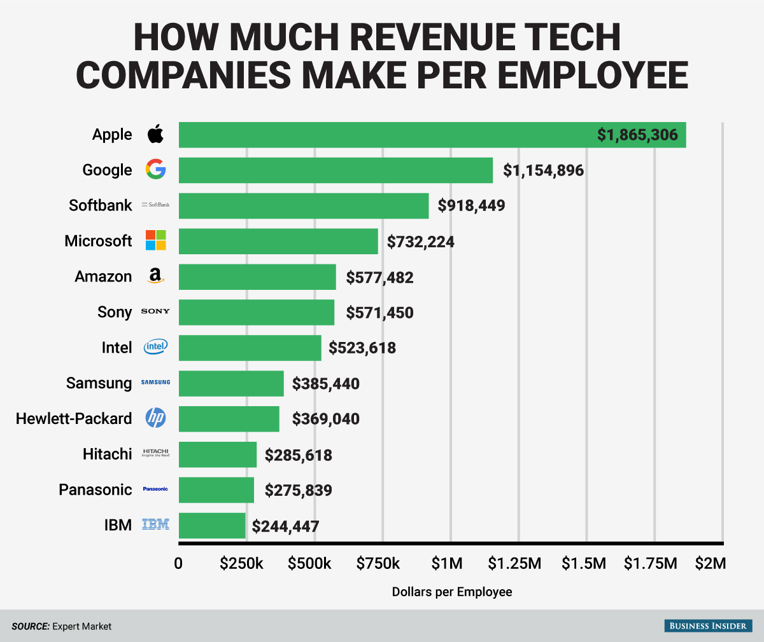
Revenue Per Employee
The average fast growing company is generating $230k – 310k per employee in revenue.
EPAM: $49,805
Samsung: $385,440
Intel: $523,618
Amazon: $577,482
Microsoft: $732,224
Google: $1,154,896
Apple: $1,865,306

Slide 10
Build vs. Sell
Architecture, programming code, technologies, frameworks
vs.
Design, UX/UI, sales

Slide 11
What I need to know as a…
Outsourcing company
How to design, develop and test a software
How to search IT specialists
How to buy tennis tables
Product company
How to make a great UX/UI
How to build a product
How to find IT specialists with small salary
How to sell product
How to get money from people
How to pay taxes
How to advertise
How to protect IP
How payment systems work
How to work with outsourcing companies
How to make A/B testing
How to pitch
How to build support / callback system
How to build community
How to “exit”

Slide 12
Payment sources for the…
Outsourcing company
T&M
Fixed price
Outstaffing
Consulting (higher hourly rates)
Product company
Licenses selling
Subscriptions
In-App Purchases
Revenue sharing
Commission
Advertising
Custom projects

Slide 13
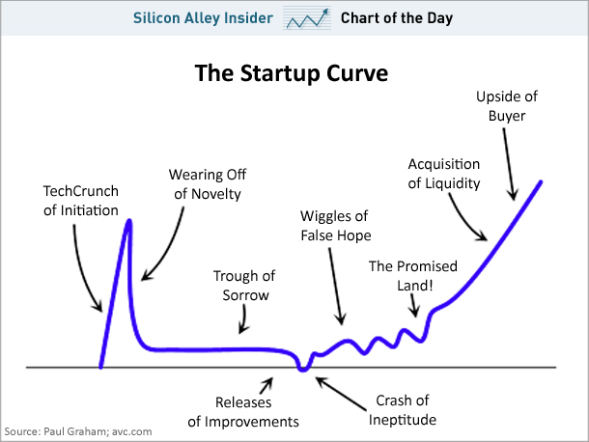
Growth strategy
Startups create new markets, “linear” businesses use existing ones.
For startups – market share is a key, for businesses – sales from the day 0.

Slide 14
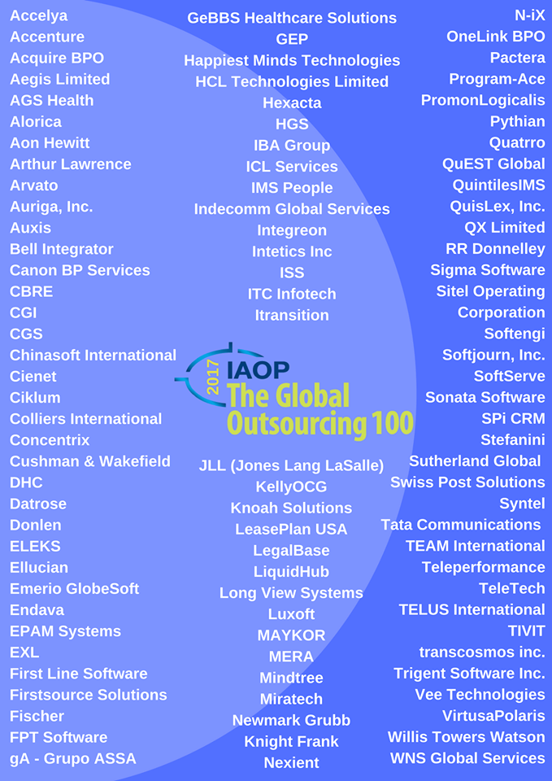
Business environment
Kabanchik -> Prom.ua
Looksery->Snapchat
Jeapie->Mobify
Viewdle->Google

Slide 15

Building ecosystem
TM valuation
Working with negative and abuse
Community building & support
Ambassadors (MVP) program
Building a partner network
Compete for the best resources
Working with government
Education & trainings

Slide 16

Success
Started as a Windows Phone development company, now extended our expertize to web, mobile (Xamarin), cloud and AI/ML/bots.
We have launched several products (indeed, they did not become the main generator of revenue).
We won a lot of international and local wards and competitions.
We are building a community.
We build a strong relations with foreign partners in different areas.
We are testing 10+ ideas/labs inside the company.

Slide 17

Fuck ups
Investors were not optimistic about the new mobile platform we invest in.
Our monetization models failed.
Developer refused to support the product.
Awards and wins in competitions are great but...
Local business environment & people are not business-friendly.
Absence of angels in 50 miles.

Slide 18
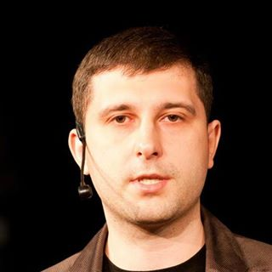
Q&A
Oleksandr Krakovetskyi
CEO DevRain Solutions
alex.krakovetskiy@devrain.com
@msugvnua
https://www.facebook.com/alex.krakovetskiy

